Slide 1
Banker’s Algorithm
Multiple instances
Each process must a priori claim maximum use
This number may not exceed the total number of resources in the system.
When a process requests a resource it may have to wait
When a process gets all its resources it must return them in a finite amount of time

Slide 2
Banker’s Algorithm
A resource allocation and deadlock avoidance algorithm.
This algorithm test for safety simulating
the allocation for predetermined maximum possible amounts of all resources,
then makes an “s-state” check to test for possible activities,
before deciding whether allocation should be allowed to continue.

Slide 3
Data Structures for the Banker’s Algorithm
n = number of processes
m = number of resources types.
Available:
Vector of length m.
If available [j] = k, there are k instances of resource type R_{j} available
Max:
n x m matrix.
If Max [i,j] = k, then process P_{i} may request at most k instances of resource type R_{j}
Allocation:
n x m matrix.
If Allocation[i,j] = k then P_{i} is currently allocated k instances of R_{j}
Need:
n x m matrix.
If Need[i,j] = k, then P_{i} may need k more instances of R_{j} to complete its task
Need [i,j] = Max[i,j] – Allocation [i,j]

Slide 4
Safety Algorithm
1. Let Work and Finish be vectors of length m and n, respectively. Initialize:
Work = Available
Finish [i] = false for i = 0, 1, …, n- 1
2. Find an i such that both:
(a) Finish [i] = false
(b) Need_{i} ≤ Work
If no such i exists, go to step 4
3. Work = Work + Allocation_{i} Finish[i] = true go to step 2
4. If Finish [i] == true for all i, then the system is in a safe state

Slide 5
Example of Banker’s Algorithm
5 processes P₀ through P₄;
3 resource types:
A (10 instances), B (5instances), and C (7 instances)
Snapshot at time T₀:
Allocation Max Available
A B C A B C A B C
P₀ 0 1 0 7 5 3 3 3 2
P₁ 2 0 0 3 2 2
P₂ 3 0 2 9 0 2
P₃ 2 1 1 2 2 2
P₄ 0 0 2 4 3 3

Slide 6
Example (Cont.)
The content of the matrix Need is defined to be Max – Allocation
Need
A B C
P₀ 7 4 3
P₁ 1 2 2
P₂ 6 0 0
P₃ 0 1 1
P₄ 4 3 1
The system is in a safe state since the sequence < P₁, P₃, P₄, P₂, P₀> satisfies safety criteria

Slide 7
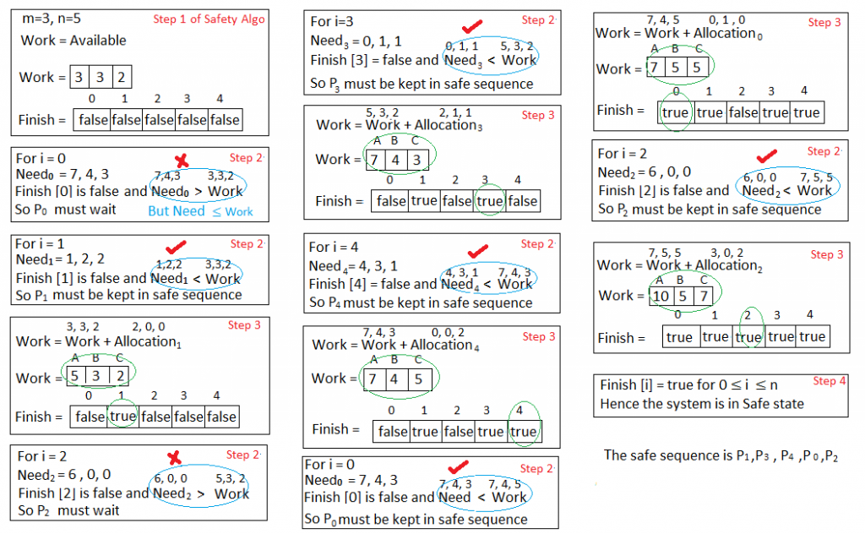
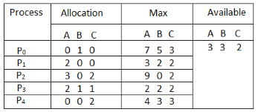
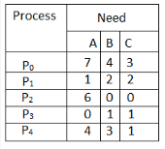
Applying the Safety algorithm on the given system,
n = number of processes
m = number of resources types
1. Let Work and Finish be vectors of length m and n, respectively. Initialize:
Work = Available
Finish [i] = false for i = 0, 1, …, n- 1

Slide 8
Applying the Safety algorithm on the given system,
n = number of processes
m = number of resources types
1. Let Work and Finish be vectors of length m and n, respectively. Initialize:
Work = Available
Finish [i] = false for i = 0, 1, …, n- 1
2. Find an i such that both:
(a) Finish [i] = false
(b) Need_{i} ≤ Work
If no such i exists, go to step 4
3. Work = Work + Allocation_{i} Finish[i] = true go to step 2
4. If Finish [i] == true for all i, then the system is in a safe state

Slide 9
Applying the Safety algorithm on the given system,
1. Let Work and Finish be vectors of length m and n, respectively. Initialize:
Work = Available
Finish [i] = false for i = 0, 1, …, n- 1
2. Find an i such that both:
(a) Finish [i] = false
(b) Need_{i} ≤ Work
If no such i exists, go to step 4
3. Work = Work + Allocation_{i} Finish[i] = true go to step 2
4. If Finish [i] == true for all i, then the system is in a safe state

Slide 10
Applying the Safety algorithm on the given system,
1. Let Work and Finish be vectors of length m and n, respectively. Initialize:
Work = Available
Finish [i] = false for i = 0, 1, …, n- 1
2. Find an i such that both:
(a) Finish [i] = false
(b) Need_{i} ≤ Work
If no such i exists, go to step 4
3. Work = Work + Allocation_{i} Finish[i] = true go to step 2
4. If Finish [i] == true for all i, then the system is in a safe state

Slide 11
Resource-Request Algorithm for Process P_{i}
Request_{i} = request vector for process P_{i}.
If Request_{i} [j] = k then process P_{i} wants k instances of resource type R_{j}
1. If Request_{i} ≤ Need_{i} go to step 2. Otherwise, raise error condition, since process has exceeded its maximum claim
2. If Request_{i} ≤ Available, go to step 3. Otherwise P_{i} must wait, since resources are not available
3. Pretend to allocate requested resources to P_{i} by modifying the state as follows:
Available = Available – Request_{i};
Allocation_{i} = Allocation_{i} + Request_{i};
Need_{i} = Need_{i} – Request_{i};
Apply Safety Algorithm
If safe ⇒ the resources are allocated to P_{i}
If unsafe ⇒ P_{i} must wait, and the old resource-allocation state is restored

Slide 12
Example: P₁ Request (1,0,2)
Check that Request ≤ Available (that is, (1,0,2) ≤ (3,3,2) ⇒ true
Allocation Need Available
A B C A B C A B C
P₀ 0 1 0 7 4 3 2 3 0
P₁ 3 0 2 0 2 0
P₂ 3 0 2 6 0 0
P₃ 2 1 1 0 1 1
P₄ 0 0 2 4 3 1
Executing safety algorithm shows that sequence < P₁, P₃, P₄, P₀, P₂> satisfies safety requirement
Can request for (3,3,0) by P₄ be granted?
Can request for (0,2,0) by P₀ be granted?

Slide 13
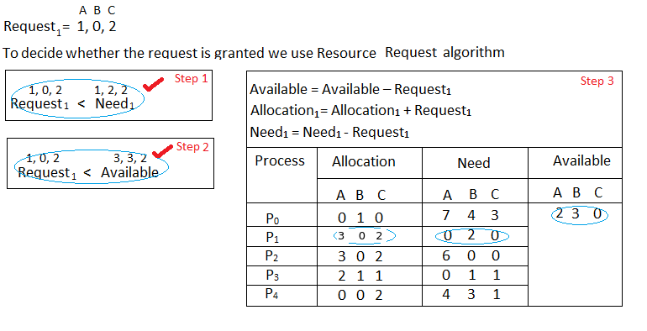
What will happen if process P1 requests one additional instance of resource type A and two instances of resource type C?

Slide 14
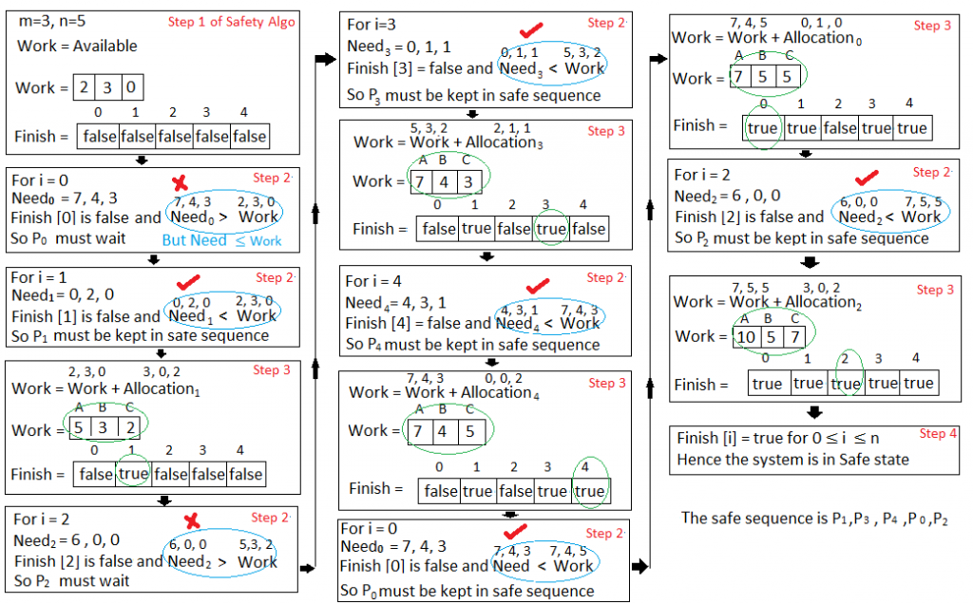
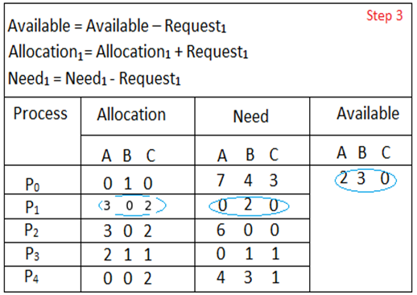
We must determine whether this new system state is safe. To do so, we again execute Safety algorithm again
1. Let Work and Finish be vectors of length m and n, respectively. Initialize:
Work = Available
Finish [i] = false for i = 0, 1, …, n- 1
2. Find an i such that both:
(a) Finish [i] = false
(b) Need_{i} ≤ Work
If no such i exists, go to step 4
3. Work = Work + Allocation_{i} Finish[i] = true go to step 2
4. If Finish [i] == true for all i, then the system is in a safe state

Slide 15
We must determine whether this new system state is safe. To do so, we again execute Safety algorithm again
1. Let Work and Finish be vectors of length m and n, respectively. Initialize:
Work = Available
Finish [i] = false for i = 0, 1, …, n- 1
2. Find an i such that both:
(a) Finish [i] = false
(b) Need_{i} ≤ Work
If no such i exists, go to step 4
3. Work = Work + Allocation_{i} Finish[i] = true go to step 2
4. If Finish [i] == true for all i, then the system is in a safe state

Slide 16
We must determine whether this new system state is safe. To do so, we again execute Safety algorithm again
1. Let Work and Finish be vectors of length m and n, respectively. Initialize:
Work = Available
Finish [i] = false for i = 0, 1, …, n- 1
2. Find an i such that both:
(a) Finish [i] = false
(b) Need_{i} ≤ Work
If no such i exists, go to step 4
3. Work = Work + Allocation_{i} Finish[i] = true go to step 2
4. If Finish [i] == true for all i, then the system is in a safe state
Hence the new system state is safe, so we can immediately grant the request for process P_{1 .}

Slide 17
Why Banker’s algorithm is named so?

Slide 18
Why Banker’s algorithm is named so?
Banker’s algorithm is named so because it is used in banking system to check whether loan can be sanctioned to a person or not.
Suppose there are n number of account holders in a bank and the total sum of their money is S.
If a person applies for a loan then the bank
first subtracts the loan amount from the total money that bank has and
if the remaining amount is greater than S then only the loan is sanctioned.

Slide 19
Why Banker’s algorithm is named so?
It is done because if all the account holders comes to withdraw their money then the bank can easily do it.
Bank would never allocate its money in such a way that it can no longer satisfy the needs of all its customers.
The bank would try to be in safe state always.

